Slide 1




Slide 2
Progress towards
the 90-90-90 Target
in China
Zunyou Wu
China CDC

Slide 3
Annual Reported HIV/AIDS cases
HIV Epidemic continue to Spread in China
Annual Newly Reported Cases

Slide 4
AIDS Remain No. 1 Killer among all Inf. Dis. in China, 2018
Inf. Dis. | Death |  | Mortality(/100,000) | Proportion%
Total | 22924 |  | 1.64
AIDS | 19107 |  | 1.37 | 83
TB | 2236 |  | 0.16 | 10
Viral Hepatitis | 606 |  | 0.04 | 3
Rabies | 426 |  | 0.03 | 2
Flu | 144 |  | 0.01 | 1
AIDS accounted for 83% of Total Inf. Dis Death;
AIDS death was 5 times as all other inf. Dis.

Slide 5
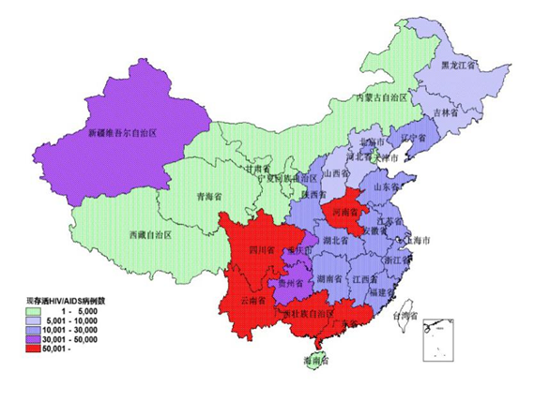
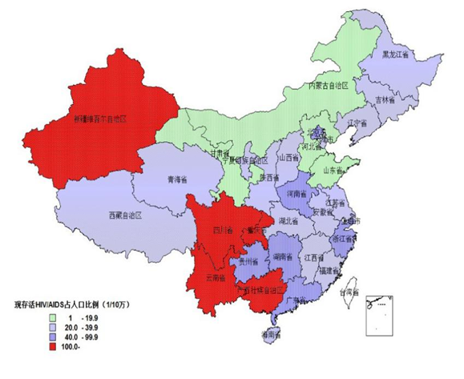
Geographic Distribution of Cases
By cases
By prevalence
Uneven Distribution, MANY epidemics

Slide 6
Majority male, concentrated in 20-49
3.7 ：1
Male
Female

Slide 7
HIV Transmission Modes over Time
Proportion (%)

Slide 8
Annual Number of HIV Tests in China (million)
8

Slide 9
Annual Number of HIV/AIDS Diagnosed
9

Slide 10
Number of PLWH on ART in China
Number PLWH on ART (10,000)
10

Slide 11
90-90-90 in China
 | 2005 | 2007 | 2009 | 2011 | 2013 | 2015 | 2018
Diagnose | 21% | 30% | 37% | 45% | 54% | 68% | 69%
ART Coverage | 9.8% | 20% | 23% | 35% | 51% | 67% | 83%
Viral suppression | - | - | - | 85% | 86% | 90% | 94%
11

Slide 12
90-90-90 in Selected Provinces in China 2018
 | Beijing | Tianjin | Shanghai | Chongqing | Yunnan | Guizhou | Hunan | China
Diagnose | 80% | 58% | <50% | 72% | 81% | 61% | 54% | 69%
ART Coverage | 90% | 80% | 82% | 79% | 88% | 70% | 73% | 83%
Viral suppression | 99% | 97% | 96% | 95% | 96% | 92% | 94% | 94%
12

Slide 13
Challenges
The most challenge is the first diagnosis;
The number of PLWH is difficult to know.
The number of PLWH is based on estimation, that has considerable uncertainty.
13

